Slide 1
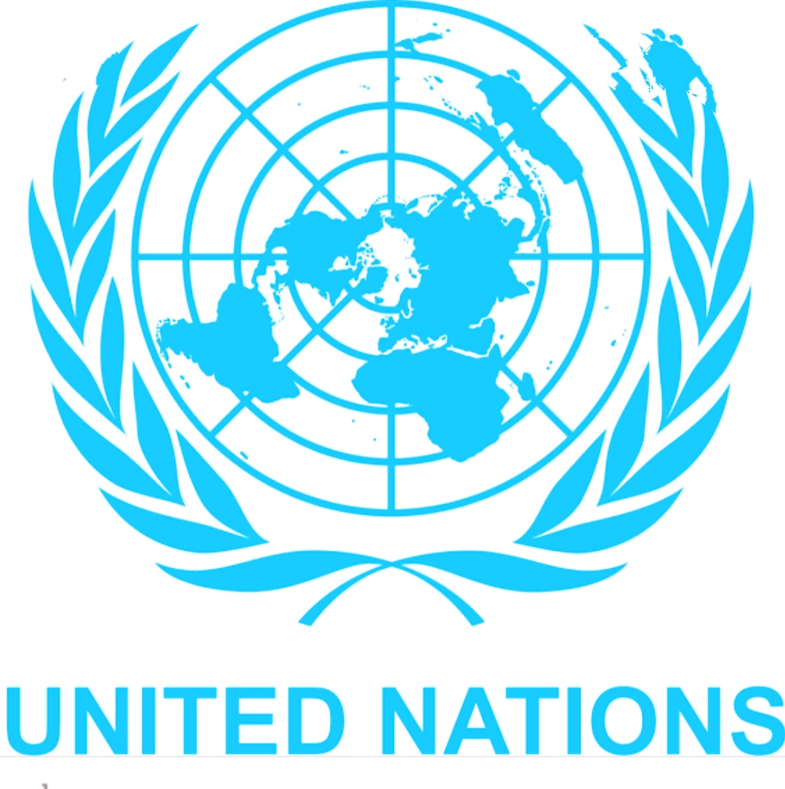
United Nations Organization (UNO)

Slide 2
Introduction
United Nations (UN) is an international organization came into force on 24/10/1945. Every year 24th Oct is celebrated as ‘United Nations Day’.
The term United Nations coined by President Franklin D. Roosevelt.
Original members 51 states, currently made up of 193 Member States (2 non State).
The UN was founded as a successor to the League of Nations.
Purpose : to maintain international peace & security;
to develop friendly relations among nations.
Official languages are Arabic, Chinese, English, French, Russian, Spanish.
Preamble of UN Charter : “We the people of the United Nations”
Principles : Sovereign Equality; peaceful settlements of international disputes;
non-intervention

Slide 3
Founding of UNO
1. 1941August: Signing of the Atlantic Charter by the US President Franklin D. Roosevelt and British PM Winston S. Churchill
2. 1942 January: 26 Allied nations fighting against the Axis Powers meet in Washington, D.C., to support the Atlantic Charter and sign the ‘Declaration by United Nations’
3. 1943 December: Tehran Conference Declaration of the Three Powers (US, Britain and Soviet Union)
4. 1945 February: Yalta Conference of the ‘Big Three’ (Roosevelt, Churchill and Stalin) decides to organize a United Nations conference on the proposed world organization
5. April-May: The 2-month long United Nations Conference on International Organization at San Francisco
6. 1945 June 26: Signing of the UN Charter by 50 nations (Poland signed on October 15; so the UN has 51 original founding members)
7. 1945 October 24: the UN was founded (hence October 24 is celebrated as UN Day)
8. 1945 October 30: India joins the UN

Slide 4
Organs of UNO
Main organs of the UN are
1. the General Assembly
2. the Security Council
3. the Economic and Social Council
4. the Trusteeship Council
5. the International Court of Justice (ICJ)
6. the UN Secretariat.

Slide 5
General Assembly
The General Assembly is the main deliberative, policymaking and representative organ of the UN.
All 193 Member States of the UN are represented in the General Assembly, making it the only UN body with universal representation.
Each year, in September, the full UN membership meets in the General Assembly Hall in New York for the annual General Assembly session, and general debate, which many heads of state attend and address.
Decisions on important questions, such as those on peace and security, admission of new members and budgetary matters, require a two-thirds majority of the General Assembly.
Decisions on other questions are by simple majority.

Slide 6
Security Council
It has primary responsibility, under the UN Charter, for the maintenance of international peace and security.
The Security Council is made up of fifteen member states, consisting of five permanent members—China, France, Russia, the United Kingdom, and the United States—and ten non-permanent members elected for two-year terms by the General Assembly on a regional basis.
"Veto power" refers to the power of the permanent member to veto (Reject) any resolution of Security Council.
The unconditional veto possessed by the five governments has been seen as the most undemocratic character of the UN.

Slide 7
Economic and Social Council (ECOSOC)
It has 54 Members, elected by the General Assembly for overlapping three-year terms.
It is the United Nations’ central platform for reflection, debate, and innovative thinking on sustainable development.
Each year, ECOSOC structures its work around an annual theme of global importance to sustainable development.
This ensures focused attention, among ECOSOC’s array of partners, and throughout the UN development system.
It coordinates the work of the 14 UN specialized agencies, ten functional commissions and five regional commissions, receives reports from nine UN funds and programs and issues policy recommendations to the UN system and to Member States.

Slide 8
Trusteeship Council
It was established in 1945 by the UN Charter, under Chapter XIII.
Trust territory is a non-self-governing territory placed under an administrative authority by the Trusteeship Council of the United Nations.
A League of Nations mandate was a legal status for certain territories transferred from the control of one country to another following World War I, or the legal instruments that contained the internationally agreed-upon terms for administering the territory on behalf of the League of Nations.
By 1994, all Trust Territories had attained self-government or independence. The Trusteeship Council suspended operation on 1 November 1994.

Slide 9
International Court of Justice (ICJ)
The International Court of Justice is the principal judicial organ of the United Nations.
It was established in June 1945 by the Charter of the United Nations and began work in April 1946.
The ICJ is the successor of the Permanent Court of International Justice (PCIJ), which was established by the League of Nations in 1920.

Slide 10
Secretariat
The Secretariat comprises the Secretary-General and tens of thousands of international UN staff members who carry out the day-to-day work of the UN as mandated by the General Assembly and the Organization's other principal organs.
The Secretary-General is chief administrative officer of the Organization, appointed by the General Assembly on the recommendation of the Security Council for a five year, renewable term.
UN staff members are recruited internationally and locally, and work in duty stations and on peacekeeping missions all around the world.

