Slide 1
K.L.E.Society’s B.V. Bellad Law College, Belagavi
Professional Ethics

Slide 2
DRESS CODE OF AN ADVOCATE
Miss Gopika B.Hosamani
Assistant Professor

Slide 3
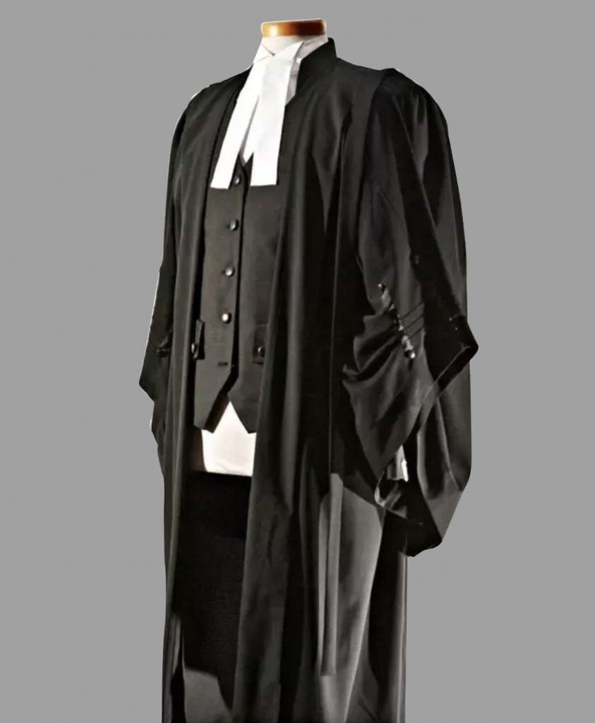
Every profession has a certain dress code, and the people belong to a particular profession are recognised by their attire. Dress code is a symbol of confidence, discipline and profession so as Lawyers dress code.
Dress code is a symbol of confidence, a symbol of discipline and a symbol of the profession, a proud part of an individual’s personality for a professional.
A lawyer’s dress code in India is governed by the Bar Council of India Rules under the Advocates Act, 1961, which make it mandatory for a every lawyer to wear a black robe or coat with white shirt and a white neckband. Let a look at the evolution of the Legal dress code.
The balance between maintaining court’s decorum and permitting freedom in individual’s lifestyle is most well defined in a lawyer’s dress code. The professional environment generally is marked by a code for dressing- in terms of color, style.

Slide 4
ಕೋಶ Introduction of Lawyer’s Dress Code
Traditionally, English court regulated Barrister’s dress code in such a manner, that even the growth of attorney’s beard or cut of his clothes was subject to scrutiny. India in terms of lawyer’s dress code inherited the system after British rule with minor modifications with times. The present article captures the journey.
Black and white: Is a symbol of the legal profession throughout world barring few exceptions. Black color generally has many different overtones. Like every color, it has both positive and negative connotations. So, on one hand, it signifies death, evil and mystery while on the other hand, it signifies the strength and authority.
The black color was chosen because of two reasons. Firstly, colors and dyes were not readily available back then. Purple signified royalty and thus, the only abundant fabric color left was black. However, the main reason behind wearing a black coat is because black is the color of authority and power. Black represents submission of oneself. Just like priests wear black to show their submission to God, lawyers wear black to show their submission to justice. The color white signifies light, goodness,

Slide 5
The black color was chosen because of two reasons. Firstly, colors and dyes were not readily available back then. Purple signified royalty and thus, the only abundant fabric color left was black. However, the main reason behind wearing a black coat is because black is the color of authority and power. Black represents submission of oneself. Just like priests wear black to show their submission to God, lawyers wear black to show their submission to justice. The color white signifies light, goodness,

Slide 6
The color white signifies light, goodness, innocence, and purity. As a legal system is the only hope of justice for a common man, the color white is chosen to represent him. As the Indian system is influenced by its British rulers due to their reign, the Advocate’s Act of 1961 makes it mandatory for a lawyer to wear a black robe or coat with a white neckband on top of it in the continuity of the same. Lawyers both the sides- petitioner and respondent wear a similar dress code. The significance of the color also highlights that law is blind. To say that it is only based differentiates on the weight of evidence and not on any other factor.

Slide 7
The white neckbands too have their origins rooted in England. In the old English Courts, the barristers-at-law used to wear white bands as part of their uniform. Since the Barristers were the first lawyers of Indian Courts, their dress was adopted as a symbol of advocates in our country. The two pieces of white cloth joined together to form the advocate’s bands represent the Tablets of the Laws or Tablets of Stone. These are the tablets that, according to the Christian belief, were used by Moses for inscribing the 10 commandments, which he received from a burning bush on Mt. Sinai. The 10 commandments are believed to be the first example of a uniform coded law. The shape of the band is also similar to the rounded off rectangular tablets. Thus, the white advocate’s bands represent the upholding of the laws of God and of men.

Slide 8
The Regulations of the Bar Council of India
Section 49 of the above Rules govern the dress code for the advocates appearing in the Supreme Court, High Courts, Subordinate Courts, Tribunals or Authorities. They shall wear the following as part of their dress, which shall be sober and dignified.
I. Dress Code for Advocates in India
Part VI: Chapter IV of Bar Council of India Rules: Rules under Section 49(1) (gg) of the Advocates Act, 1961.
1. COAT
(a) A black buttoned up coat, chapkan, achkan, black sherwani and white bands with Advocates’ Gowns.
(b) A black open breast coat, White shirt, White collar, stiff or soft, and white bands with Advocates’ Gowns.
In either case wear long trousers (White, Black Striped or gray) or dhoti excluding jeans.
2. BLACK TIE
Provided further that in courts other than the Supreme Court, High Courts, District Courts, Sessions Courts or City Civil Courts, a black tie may be worn instead of bands.

Slide 9
II. Lady Advocates
Lady Advocates may wear either the dress prescribed in Sub-Rule (b) or the following:
(a) Black full sleeve jacket or blouse, White collar, Stiff or soft, with white bands and Advocates’ gowns. White blouse with or without a collar, with white bands and with a black open breasted coat.
OR
A. SAREE OR LONG SKIRT
(b) Sarees or long skirts (white or black or any mellow or subdued color without any print or design) or flare (white, black or black stripped or gray) or Punjabi dress churidar kurta or Salwar-Kurta with or without dupatta (white or black) or traditional dress with black coat and bands.
.

Slide 10
C. BLACK COAT
Except in Supreme Court and High Courts, during summer wearing black coat is not mandatory. These amendments have been approved by the Hon’ble Chief Justice of India vide letter Dated. 12-11 -2001 subject to the incorporation of ‘except in Supreme Court and High Court during summer wearing a black coat is not mandatory’ which is now added as Rule IV of the Bar Council Rules. This was based on representation based on a group of lawyers from Tamil Nadu.
The amended rules in chapter IV, part VI of the Bar Council of India Rules relating to “Form of Dresses or robes to be worn by Advocates” had been communicated to the State Bar Councils vide our circular No. 6/2002 dated 25.01.2002. The Bar Council of India at its meeting dated 23rd/24th February 2002 considered the doubts raised relating to dress rules and after consideration, the following decision has been taken:
“In the change brought about in the dress rules, there appears to be some confusion in so far as the sub courts are concerned. For removal of any doubt it is clarified that so far as the courts other than Supreme Court and High Courts are concerned during summer while wearing black coat is not mandatory, the advocates may appear in a white shirt with black or striped or gray pant with black tie or band and collar”.

Slide 11
Conclusion
A Lawyer is an officer of the court and he should support court’s decorum.
Wearing of gown started as a symbol of mourning in England. It was then that uniform for lawyers was designated.
Wigs were inspired from the court of King Charles II, despite going out of fashion was worn to distinguish legal professionals.
The black coat is because black is the color of authority and power. Black represents submission of oneself. The color white signifies light, goodness, innocence, and purity. The significance of the color also highlights that law is blind. To say that it is only based differentiates on the weight of evidence and not on any other factor.
The white neckbands have their origins rooted in England. In the old English Courts, the barristers-at-law used to wear white bands as part of their uniform. Since the Barristers were the first lawyers of Indian Courts, their dress was adopted as a symbol of advocates in our country. The two pieces of white cloth joined together to form the advocate’s bands represent the Tablets of the Laws or Tablets of Stone.
The Supreme Court has dismissed a petition seeking a directive to apply a uniform dress code for both senior advocates and other advocates.
Part VI: Chapter IV of Bar Council of India Rules: Rules under Section 49(1) (gg) of the Advocates Act, 1961. Earlier, the Bar Council did not make any rule prescribing the dress. That was left to the High Court. Acting under Section 34(1) of the Advocates Act the High Court framed rules.

Slide 12
THANK YOU

